Slide 1


Introduction to Dynamic Web Content
Charles Severance
www.dj4e.com

Slide 2
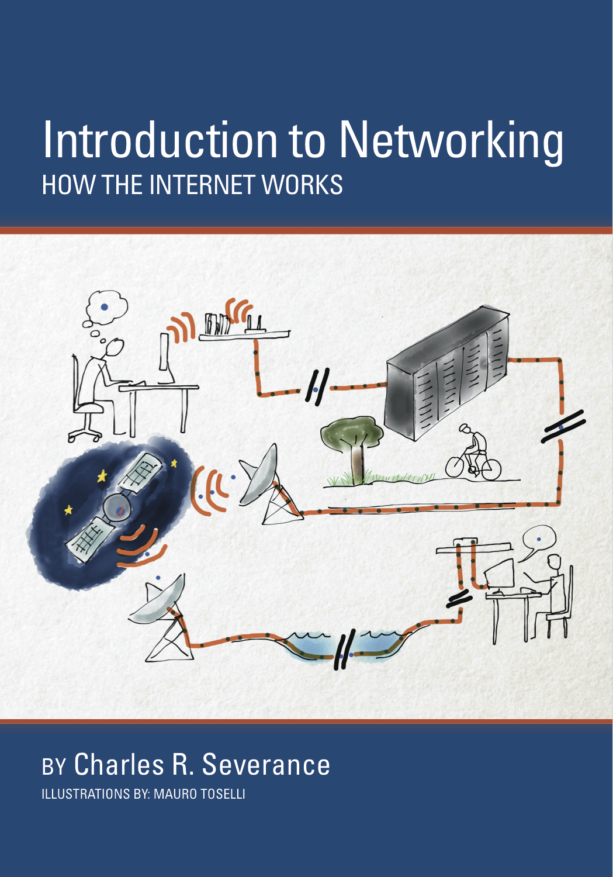
A Free Book on Networking
If you find this topic area interesting and/or need more detail
www.net-intro.com
https://www.coursera.org/learn/insidetheinternet

Slide 3
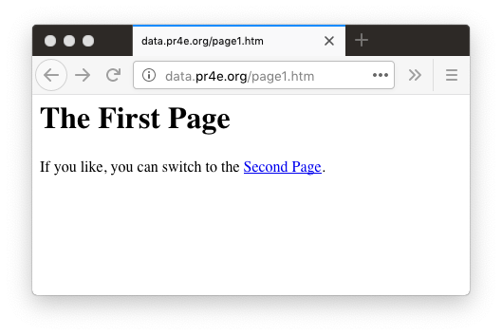

Web Application Technologies
Browser
HTML
CSS
DOM
JavaScript
JQuery
Web Server
DJango / Flask
Sqlite3 / MySQL
http://data.pr4e.org/page1.htm

Slide 4
Getting Data from the Server
Each time the user clicks on an anchor tag with an href = value to switch to a new page, the browser makes a connection to the web server and issues a “GET” request - to GET the content of the page at the specified URL.
The server returns the HTML document to the browser, which formats and displays the document to the user.

Slide 5
Web Server
80
Browser
App
Click

Slide 6
Web Server
80
Request
GET http://data.pr4e.org/page2.htm
Browser
App
Click

Slide 7
Web Server
<h1>The Second Page</h1><p>If you like, you can switch back to the <a href="page1.htm">First Page</a>.</p>
80
Response
Request
GET http://data.pr4e.org/page2.htm
Browser
App
Click

Slide 8
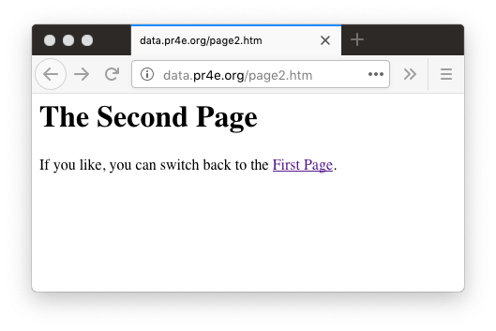
Web Server
<h1>The Second Page</h1><p>If you like, you can switch back to the <a href="page1.htm">First Page</a>.</p>
80
Response
Request
GET http://data.pr4e.org/page2.htm
Browser
App
Click
Parse/
Render

Slide 9
Network Sockets
Phone calls for pairs of applications

Slide 10
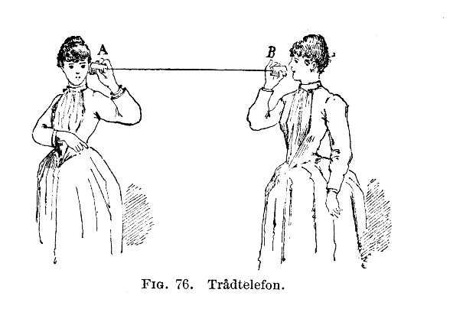
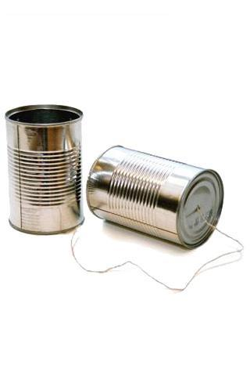
http://en.wikipedia.org/wiki/Tin_can_telephone
http://www.flickr.com/photos/kitcowan/2103850699/

Slide 11
TCP Connections / Sockets
“In computer networking, an Internet socket or network socket is an endpoint of a bidirectional inter-process communication flow across an Internet Protocol-based computer network, such as the Internet.”
Application
Process
Application
Process
Internet
http://en.wikipedia.org/wiki/Internet_socket

Slide 12
TCP Port Numbers
A port is an application-specific or process-specific software communications endpoint
It allows multiple networked applications to coexist on the same server
There is a list of well-known TCP port numbers
http://en.wikipedia.org/wiki/TCP_and_UDP_port

Slide 13
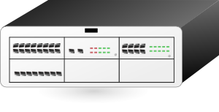

www.dj4e.com
74.208.28.177
Incoming E-Mail
25
Login
23
blah blah blah blah
Web Server
80
Web Server
443
Personal Mail Box
109
Personal Mail Box
110
Clipart: http://www.clker.com/search/networksym/1

Slide 14
HyperText Transfer Protocol
Wandering through linked documents on the Internet

Slide 15
Uniform Resource Locator
http://data.pr4e.org/page1.htm
protocol
host
document

Slide 16
HTTP - HyperText Transfer Protocol
The dominant Application Layer Protocol on the Internet
Invented for the Web - to retrieve HTML, Images, Documents, etc.
Extended to handle data in addition to documents - RSS, Web Services, etc.
Basic Concept: Make a connection - Request a document - Retrieve the document - Close the connection
Internet and sockets were created in the 1970's, HTTP was invented in 1990 and is an application protocol that runs atop sockets

Slide 17
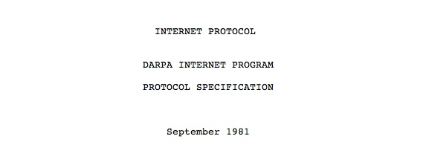
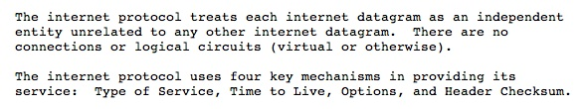
Internet Standards
The standards for all of the Internet protocols (inner workings) are developed by an organization
Internet Engineering Task Force (IETF)
www.ietf.org
Standards are called “RFCs” - “Request for Comments”
Source: http://tools.ietf.org/html/rfc791

Slide 18
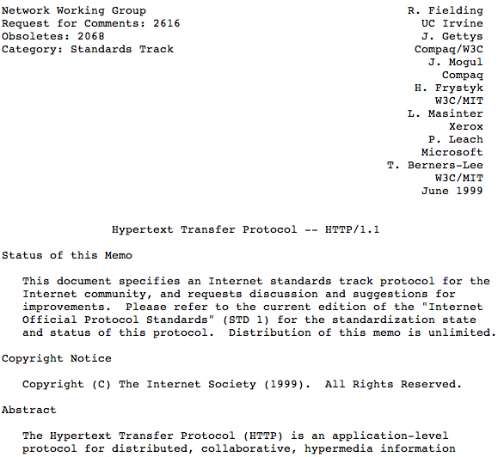
http://www.w3.org/Protocols/rfc2616/rfc2616.txt

Slide 19
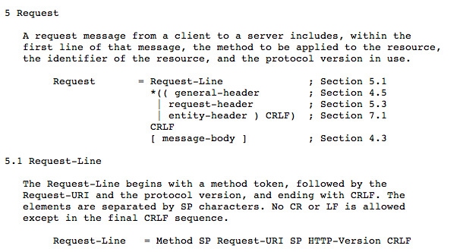

Slide 20
Making an HTTP Request
Connect to the server like data.pr4e.org
- a “handshake”
Request a document
GET http://data.pr4e.org/page1.htm HTTP/1.0
GET http://www.mlive.com/ann-arbor/ HTTP/1.0
GET http://www.facebook.com HTTP/1.0

Slide 21
Note – Telnet is not installed by default on most systems
$ telnet data.pr4e.org 80
Trying 74.208.28.177...
Connected to data.pr4e.org character is '^]'.
GET http://data.pr4e.org/page1.htm HTTP/1.0
HTTP/1.1 200 OK
Date: Thu, 04 Jan 2018 14:45:10 GMT
Server: Apache/2.4.7 (Ubuntu)
Last-Modified: Mon, 15 May 2017 11:11:47 GMT
Content-Type: text/html
<h1>The First Page</h1>
<p>If you like, you can switch to
the <a href="http://www.dr-chuck.com/page2.htm">Second Page</a>.</p>
Connection closed by foreign host.
Web Server
Browser
Notes:
brew install telnet

Slide 22
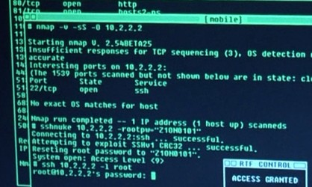


Accurate Hacking in the Movies
Matrix Reloaded
Bourne Ultimatum
Die Hard 4
...
http://nmap.org/movies.html

Slide 23
Simple "Browser" in Python

Slide 24
The World's Simplest Browser
import socket
mysock = socket.socket(socket.AF_INET, socket.SOCK_STREAM)
mysock.connect(('data.pr4e.org', 80))
cmd = 'GET http://data.pr4e.org/page1.htm HTTP/1.0\r\n\r\n'.encode()
mysock.send(cmd)
while True:
data = mysock.recv(512)
if len(data) < 1:
break
print(data.decode(),end='')
mysock.close()
https://www.dj4e.com/code/http/socket1.py

Slide 25
$ python3 socket1.py
HTTP/1.1 200 OK
Date: Sat, 19 Jan 2019 04:23:25 GMT
Server: Apache/2.4.18 (Ubuntu)
Last-Modified: Mon, 15 May 2017 11:11:47 GMT
ETag: "80-54f8e1f004857"
Accept-Ranges: bytes
Content-Length: 128
Cache-Control: max-age=0, no-cache, no-store, must-revalidate
Pragma: no-cache
Expires: Wed, 11 Jan 1984 05:00:00 GMT
Connection: close
Content-Type: text/html
<h1>The First Page</h1>
<p>
If you like, you can switch to the
<a href="http://data.pr4e.org/page2.htm">
Second Page</a>.
</p>
import socket
mysock = socket.socket(socket.AF_INET, socket.SOCK_STREAM)
mysock.connect(('data.pr4e.org', 80))
cmd = 'GET http://data.pr4e.org/page1.htm HTTP/1.0\r\n\r\n'.encode()
mysock.send(cmd)
while True:
data = mysock.recv(512)
if len(data) < 1:
break
print(data.decode(),end='')
mysock.close()

Slide 26
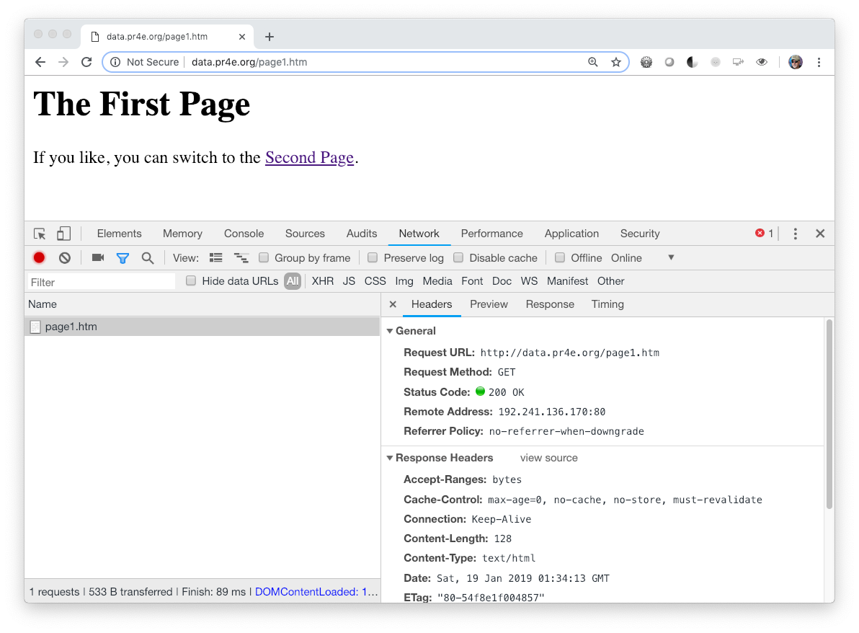
Viewing Headers – Browser Developer Mode
Chrome: View > Developer
FireFox: Tools -> Web Developer -> Toggle
Safari: Preferences > Advanced > Show Develop Menu

Slide 27
In the server
… the mighty server

Slide 28
Web Server
<h1>The Second Page</h1><p>If you like, you can switch back to the <a href="page1.htm">First Page</a>.</p>
80
Response
Request
GET http://data.pr4e.org/page2.htm
Browser
App
Click
Parse/
Render

Slide 29
Web Server
?????
80
<h1>The Second Page</h1><p>If you like, you can switch back to the <a href="page1.htm">First Page</a>.</p>
Response
Request
Browser
App
GET http://data.pr4e.org/page2.htm

Slide 30
The World's Simplest Web Server
from socket import *
def createServer():
serversocket = socket(AF_INET, SOCK_STREAM)
try :
serversocket.bind(('localhost',9000))
serversocket.listen(5)
while(1):
(clientsocket, address) = serversocket.accept()
rd = clientsocket.recv(5000).decode()
pieces = rd.split("\n")
if ( len(pieces) > 0 ) : print(pieces[0])
data = "HTTP/1.1 200 OK\r\n"
data += "Content-Type: text/html; charset=utf-8\r\n"
data += "\r\n"
data += "<html><body>Hello World</body></html>\r\n\r\n"
clientsocket.sendall(data.encode())
clientsocket.shutdown(SHUT_WR)
except KeyboardInterrupt :
print("\nShutting down...\n");
except Exception as exc :
print("Error:\n");
print(exc)
serversocket.close()
print('Access http://localhost:9000')
createServer()
https://www.dj4e.com/code/http/server.py

Slide 31
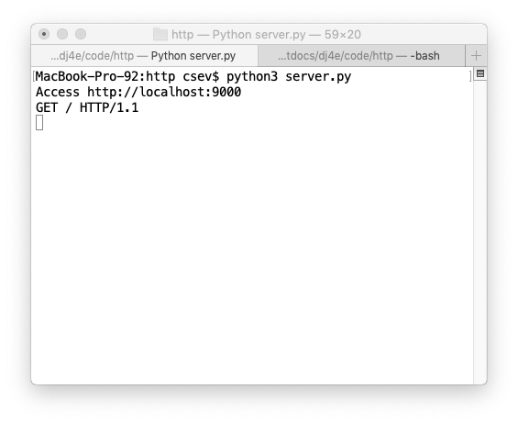
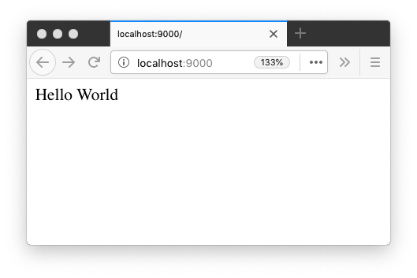
Browser / Server Communication

Slide 32
A Very Simple Web Client
import socket
mysock = socket.socket(socket.AF_INET, socket.SOCK_STREAM)
mysock.connect(('127.0.0.1', 9000))
cmd = 'GET http://127.0.0.1/romeo.txt HTTP/1.0\r\n\r\n'.encode()
mysock.send(cmd)
while True:
data = mysock.recv(512)
if len(data) < 1:
break
print(data.decode(),end='')
mysock.close()
https://www.dj4e.com/code/http/client1.py

Slide 33
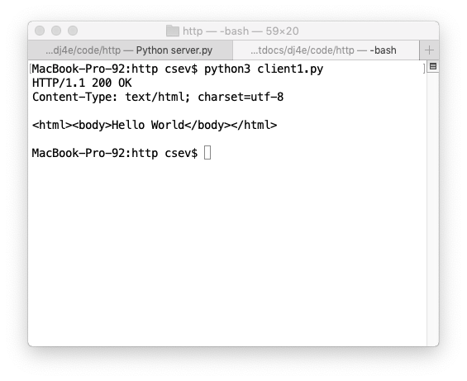
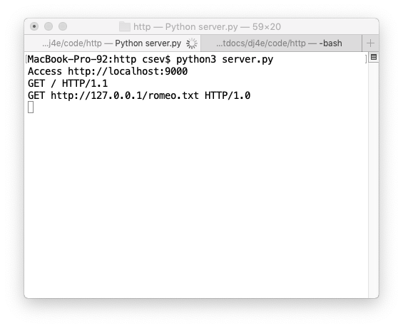
Client / Server Communication

Slide 34
An Even Simpler Web Client
import urllib.request
fhand = urllib.request.urlopen('http://127.0.0.1:9000/romeo.txt')
for line in fhand:
print(line.decode().strip())
https://www.dj4e.com/code/http/client2.py

Slide 35
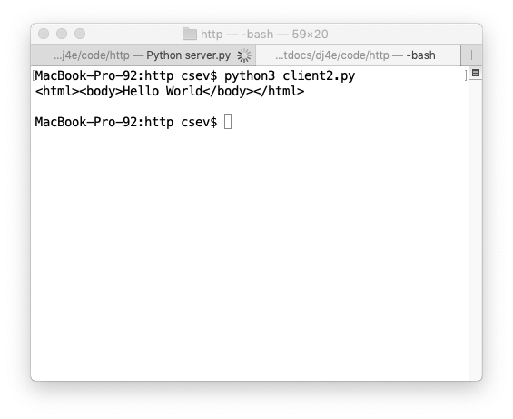
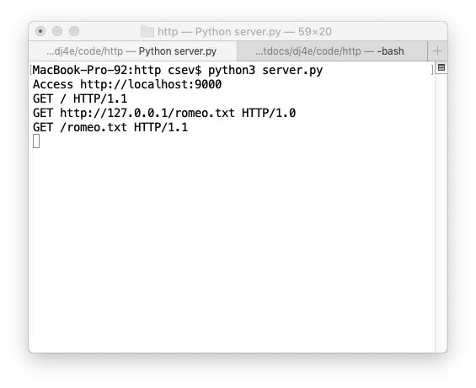
Client2 / Server Communication

Slide 36
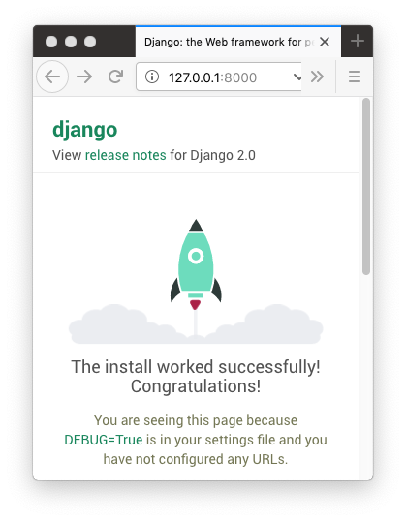
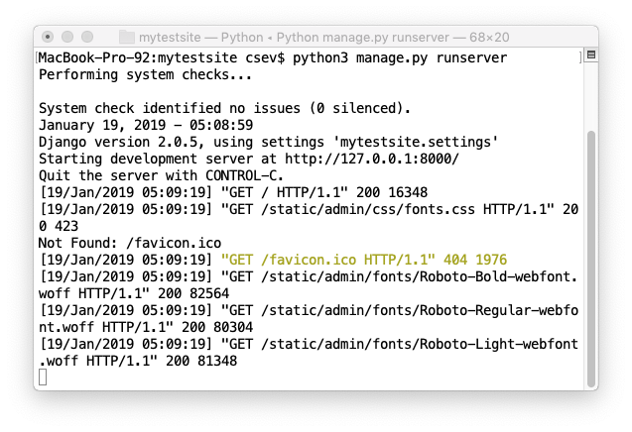
Browser / Django Communication

Slide 37
Acknowledgements / Contributions
These slides are Copyright 2019- Charles R. Severance (www.dr-chuck.com) as part of www.dj4e.com and made available under a Creative Commons Attribution 4.0 License. Please maintain this last slide in all copies of the document to comply with the attribution requirements of the license. If you make a change, feel free to add your name and organization to the list of contributors on this page as you republish the materials.
Initial Development: Charles Severance, University of Michigan School of Information
Insert new Contributors and Translators here including names and dates
Continue new Contributors and Translators here

